Slide 1
MRI Brain Tumor Segmentation
Najeebuddin Ahmed | Khanjan Dabhi Ryan Friesen | William Bugden

Slide 2
Overview
Key Terms
Motivation
Dataset
Implementation
UNet
Web-interface
Demo
Conclusion

Slide 3
Key Terms
MRI: Magnetic Resonance Imaging is a technique used to form detailed images of organs and tissue in the body
Brain Tumor: Abnormal cells that grow in the brain
Segmentation: Separation of different parts
Neural Network: Refers to systems of neurons, either organic or artificial in nature.

Slide 4
Motivation
Detecting brain tumor is a very challenging problem
Quick diagnosis is important to get patient into treatment
Effective segmentation model
Easy to use web-interface

Slide 5
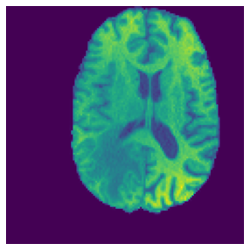
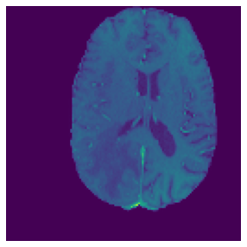
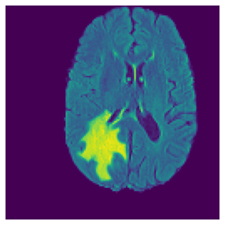
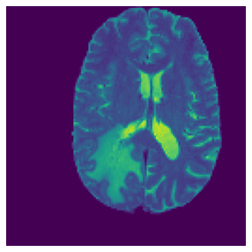
Dataset
MICCAI BraTS2020 Dataset
4 modalities: T1, T1ce, Flair, T2
Manual Segmentation labels for each tumor subregion
Dataset containing .nii files for each modality for 369 patients
T1
T1ce
Flair
T2
Image retrieved from: https://www.kaggle.com/awsaf49/brats20-dataset-training-validation

Slide 6
Implementation
This project is split into two tasks :
Machine Learning: Generate segmentation of tumor as accurately as possible
Web-interface: Given a model weight and input files create a UI which can be used to view generated segmentations

Slide 7
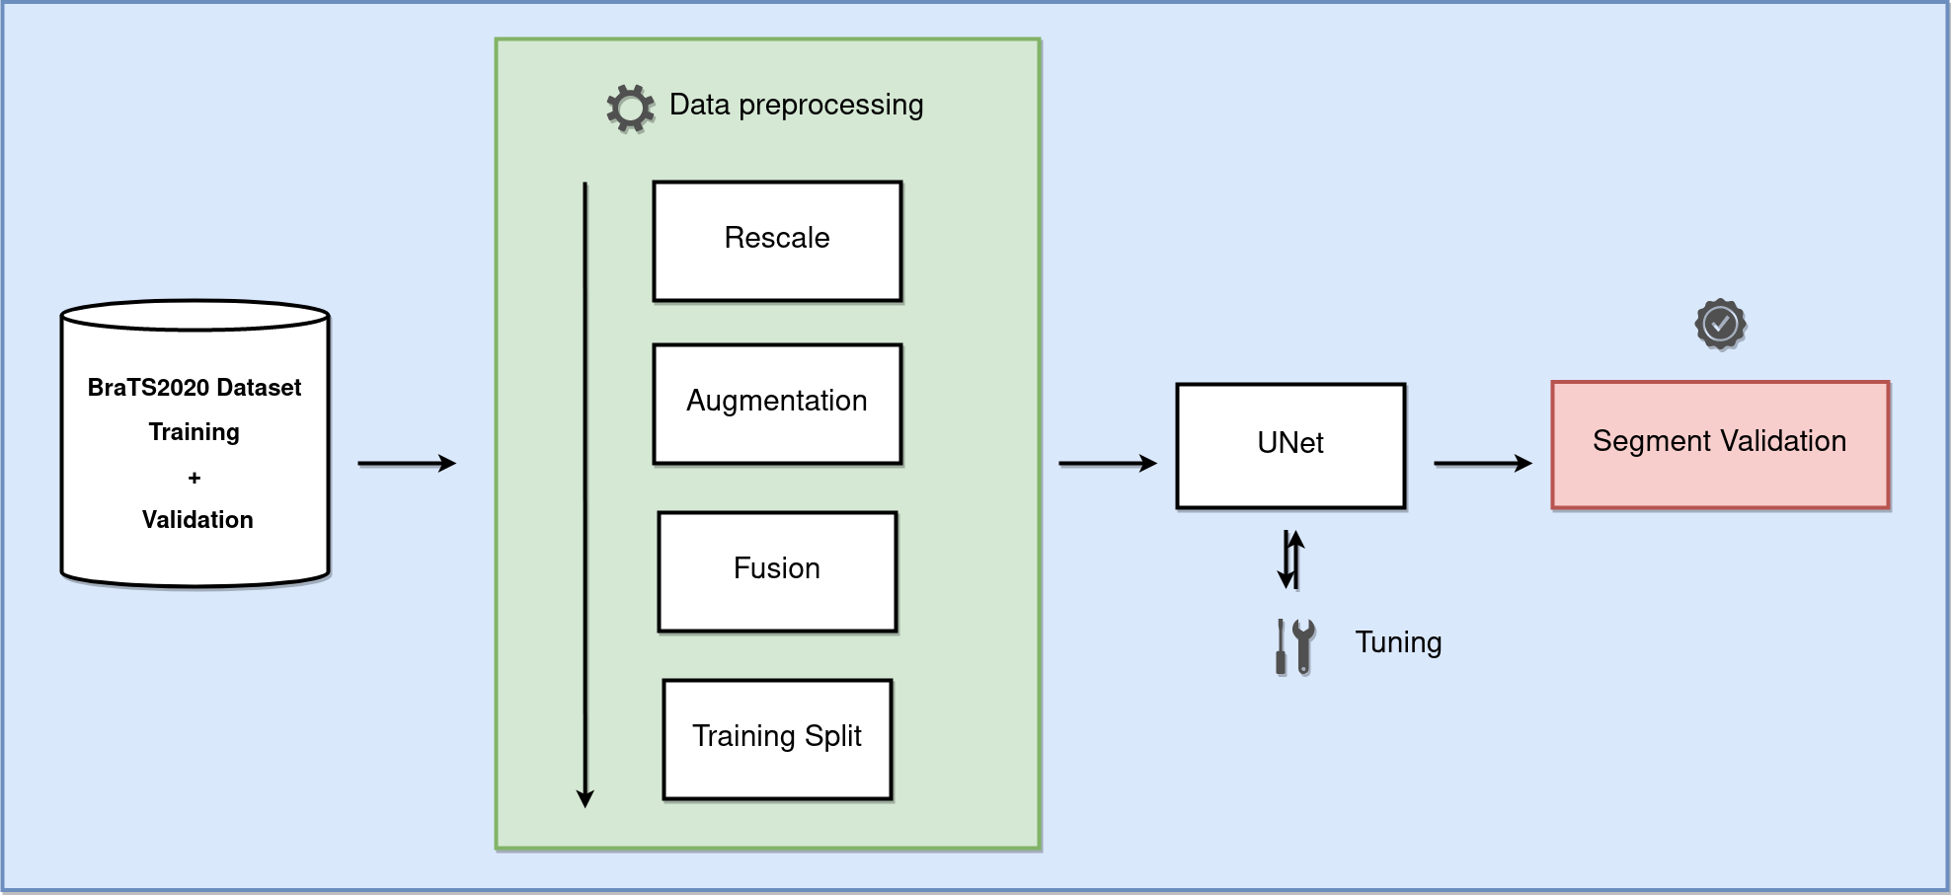

Implementation: Model Block Diagram
Image retrieved from: https://www.kaggle.com/awsaf49/brats20-dataset-training-validation

Slide 8
UNet : Why UNet?
Developed specifically for biomedical image segmentation
Trainable on small data sets
High performance metrics (given proper training, dataset and training time)
Top performers of BraTS follow UNet architecture

Slide 9
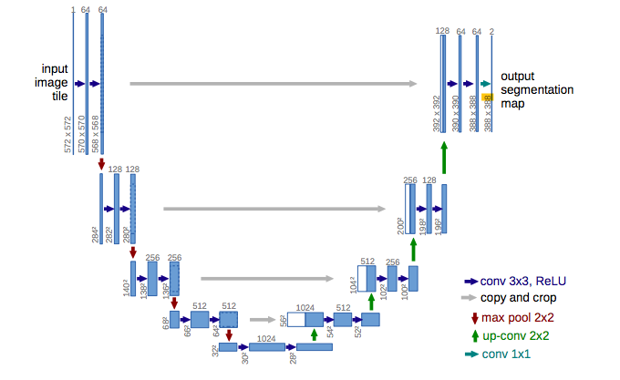
UNet :Architecture
Medical Image Computing and Computer-Assisted Intervention (MICCAI), Springer, LNCS, Vol.9351: 234--241, 2015

Slide 10
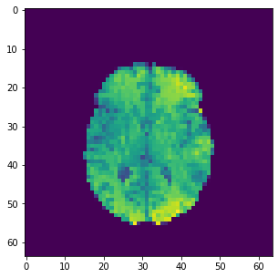
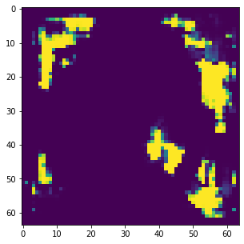
UNet: Rescale Input Size
Original Input Size: 240 * 240 * 155
Trained for sample image set of 20
Resource expensive when tried to add more inputs
Rescaled Input Size: 64 * 64 * 130
Fixed the issue of computational resources
Final results of the segmentation lost information
Final Input Size: 128 * 128 * 130
Trained complete set
No loss of information
Fig 1: Segmentation Comparison for input size 64 * 64 * 130
Image retrieved from: https://www.kaggle.com/awsaf49/brats20-dataset-training-validation

Slide 11
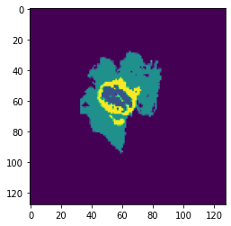
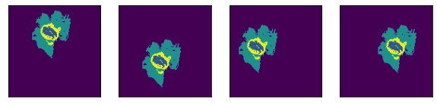
UNet: Augmentation
Primarily implemented to prevent overfitting
20% of the whole training dataset was picked at random to perform the following:
Translate(Image, Direction,Shift)
Gaussian Noise(Image,Sigma)
Rotate Image(Image, Angle)
Fig. 2: Original Image v/s Translate: Up, Down, Left, Right (Left->Right)
Image retrieved from: https://www.kaggle.com/awsaf49/brats20-dataset-training-validation

Slide 12
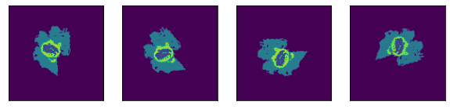
UNet: Augmentation (Contd.)
Fig. 3: Original Image v/s Rotate Angle: 10, 50, 100, 295
(Left->Right)
Image retrieved from: https://www.kaggle.com/awsaf49/brats20-dataset-training-validation

Slide 13
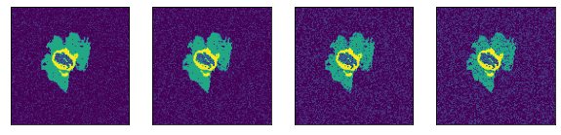
UNet: Augmentation (Contd.)
Fig. 4: Original Image v/s Gaussian Noise: 0.40, 0.50, 0.80, 1
(Left->Right)
Image retrieved from: https://www.kaggle.com/awsaf49/brats20-dataset-training-validation

Slide 14
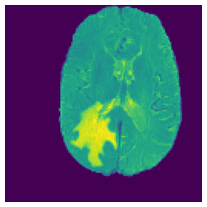
UNet: Image Fusion
Done to improve the overall performance of our model
4 modalities fused into one image using the average of each modality
T1
T1ce
Flair
T2
Fused Image
Image retrieved from: https://www.kaggle.com/awsaf49/brats20-dataset-training-validation

Slide 15
UNet: Image Fusion Results
No. of channels | T1 | T1ce | T2 | Flair | Fused(T1+T1ce+T2+Flair)
Training Data Size | 80 | 80 | 80 | 80 | 80
Dice Coefficient | 0.5545 | 0.5836 | 0.6204 | 0.6386 | 0.7012

Slide 16
UNet: Fine Tuning
Optimiser: Use the difference between true and predicted values to adjust weights
Adam - Combination of multiple optimizers
SGD - A single sample used to for gradient descent in each iteration
Learning rate: How fast the weights change in the neural network
Loss Function: Distance between current output and expected output
Binary cross-entropy - Compares each of the predicted probabilities to actual class output
Categorical cross-entropy - Calculate quantity to minimize during training
Poisson - Used for regression when modeling count data

Slide 17
UNet: Fine Tuning Results
Optimiser | Adam | Adam | Adam | SGD | SGD
Learning Rate | 0.001 | 0.1 | 0.001 | 0.001 | 0.01
Loss Function | binary cross-entropy | binary cross-entropy | categorical cross-entropy | binary cross-entropy | poisson
Dice Coefficient | 0.8124 | 0.3213 | 0.3359 | 0.5132 | 0.5828

Slide 18
UNet: Final Structure and Result
Convolution Block:
ReLU activation function
Padding same
Activation Function final layer:
Sigmoid
Cost Function:
Cross Entropy Function
Optimizer:
Adam
Input Size: 128*128
Batch Size: 32
Learning rate: 0.001
Learning Time: 4~5 hours
Epochs: 200
The number of feature map:
2 4 8 16 32
Dice Score Achieved: 0.8022!

Slide 19
Web-Interface
Who is it for?
Doctors responsible for managing brain MRI scans of one or more patients, and diagnosing brain tumors
What does it do?
Provides doctors with an easy to use interface to utilize the UNet model and view segmentation results
Aid in the swift and accurate diagnosis of brain tumors

Slide 20
Technologies Used
Node.js
Express
Pug templating engine
mongoDB
Bootstrap
jQuery
argon2id

Slide 21
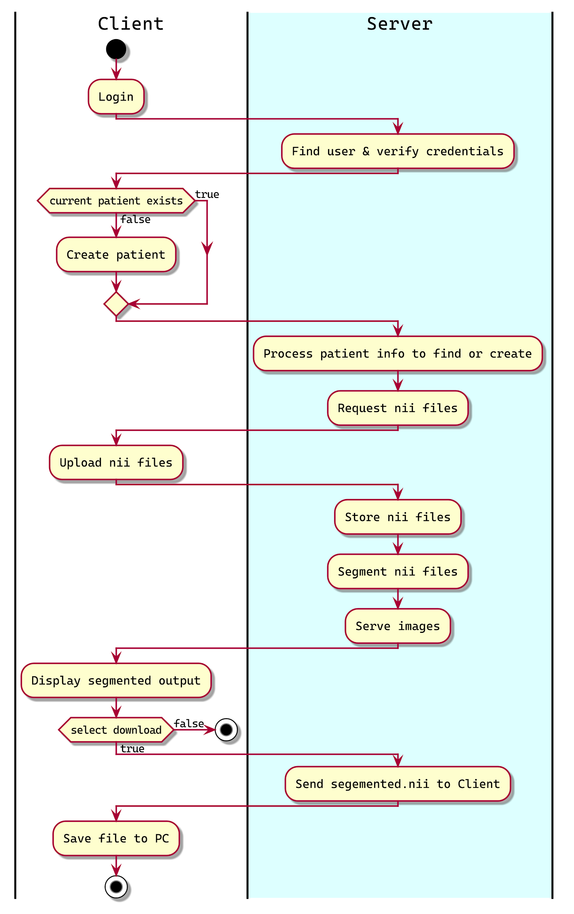
Activity Diagram
Functionality:
Add New Patients
Upload & store four types of MRI scans
Perform segmentation (UNet model)
Display labelled image slices
Download segmented nii file

Slide 22
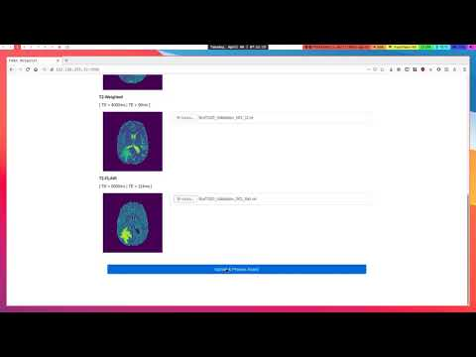
Demo

Slide 23
Problems Faced
Dealing with NIfTI files:
Use Nibable and Nilearn libraries extensively to learn how to operate .nii files
Less Computational Resources:
Solved by adding more resources such as RAM, Disk-space and GPU power by upgrading to Google Colab Pro
Managing Python dependencies for the web interface:
Manually had to install each of the dependencies

Slide 24
Future Development
Further Image Enhancement techniques can be explored
Use of DNN instead of UNet
Adding more functionality to the Web Interface
Resize the output segmentation and upload them to CBICA Image Processing Portal

Slide 25
Contributions
Model Planning and Implementation:
Najeebuddin Ahmed
Khanjan Dabhi
Web-Interface Design and Implementation:
Ryan Friesen
William Bugden

Slide 26
Thank You

